Slide 1

Key Performance Indicators
Presented by Kimberly Perron, MBA
Customer Success Instructor

Slide 2










Slide 3

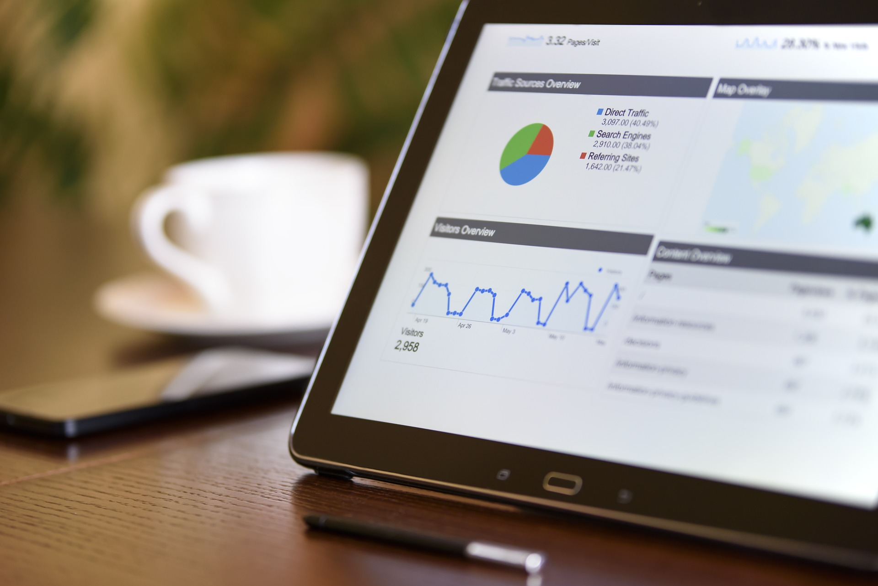

Key Performance Indicators

Slide 4
POLL?
What key performance indicator(s) does your organization track?
None yet, but we want to start
Donor/Member retention
Average gift
Fundraising ROI
Donor lifetime value
Donor growth rate
All of the above

Slide 5
KPIs – Process
Strategy
Strategy
Objective
Measure
Evaluate
Optimize
Perform
Objective
Perform
KPI
Measure
Optimize
Evaluate

Slide 6
Key Performance Indicators
Data driven metrics for critical activities
Provide insights on past
Projections for the future
Resource allocation
Continuous improvement

Slide 7
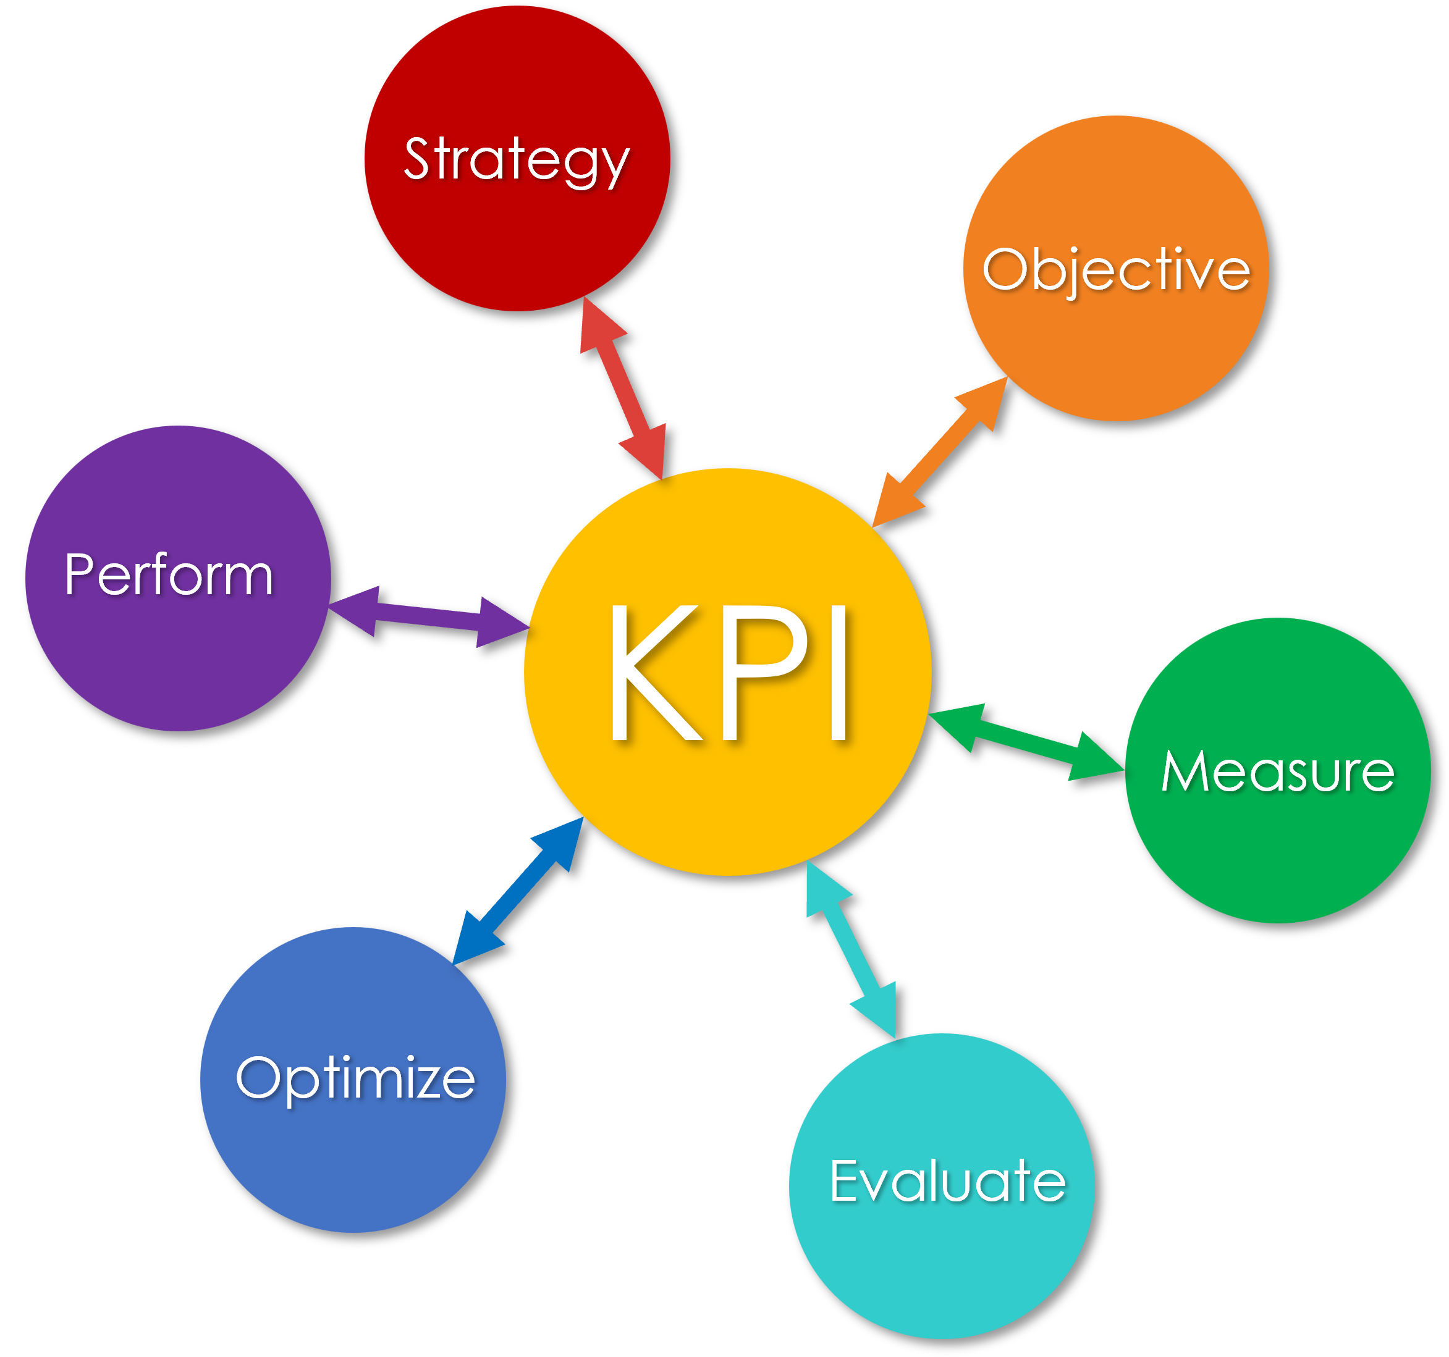
KPIs – Strategy
Focuses on ultimate vision
Defines priorities
Looks at internal and external factors
Examines the “why”

Slide 8
KPIs – Strategy
But what if we don’t have a formal strategy?
Perform a mini-strategy analysis
Why do we want this information?
What is mission-critical?
Where do we need to improve?
How can we change?

Slide 9
KPIs – Objective
Determined from strategic analysis
Activities or goals to achieve vision/mission
Track responsibilities
Identify milestones
Progress updates

Slide 10
KPIs – Objective
Examples:
Develop a donor engagement program with a goal to increase donor retention to 75% resulting in a revenue increase of $50,000 by 12/31/2024.
Implement a moves management process to identify 10 new major donors and secure $75,000 in major gifts by 7/15/2024.
Purchase a new CRM software by 3/17/2024 to consolidate various platforms and improve efficiency.

Slide 11
KPIs – Measure
Determine what metrics will show progress towards goal
Don’t need to measure everything
Establish reporting frequency
Takes time to see results

Slide 12
KPIs – Evaluate
Compare KPIs over time
Look for trends
Are actions producing expected results?
Are milestones being met?

Slide 13
KPIs – Optimize
Adjust processes
Reallocate resources
Set new targets

Slide 14
KPIs – Perform
New level of performance
Continually:
Measuring
Evaluating
Optimizing
Update/revise in next strategic analysis

Slide 15
KPIs – Examples
Fundraising metrics
Cost metrics
Engagement metrics
People metrics
Performance metrics

Slide 16
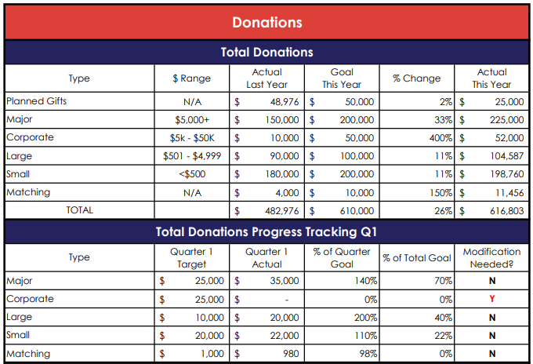
KPIs - Donations
Breakdowns from annual plan
Sort by type
Goals
Reasonable
Resources
Regular reviews for adjustments

Slide 17
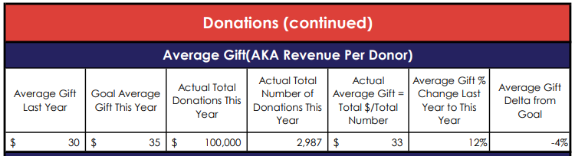
KPIs – Donations – Average Gift
Increasing by small amounts will add up
Make the case for a larger gift
Suggested amounts
What does the donation equate to in service delivery or value

Slide 18
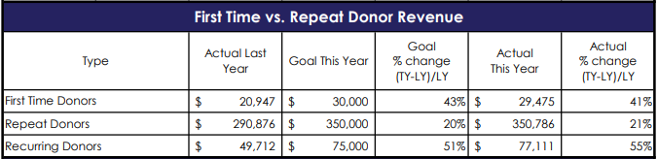
KPIs – Donors – Repeat Donors
Acquiring new donors
is expensive
Communication is key
Benefits of recurring
donors
Auto payments
Auto touch points
Small increases lead to big results

Slide 19
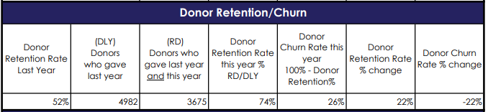
KPIs – Donors – Donor Retention
Reduce loss through better communication
Average is 40 – 45%*
Often depends on
How they were acquired
Connection to cause
*AFP Global 2022

Slide 20
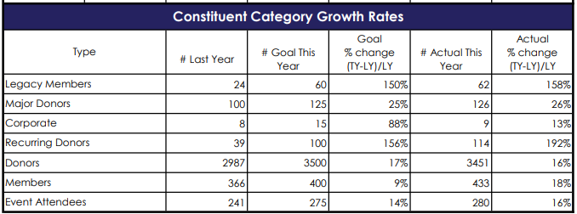
KPIs – Donors – Growth Rates
More detail, more insight
Sort by type
Focus on those with the biggest impact
Bigger impact requires more effort & resources

Slide 21
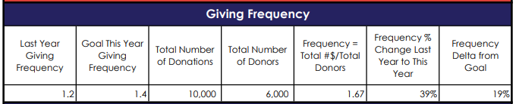
KPIs – Donors - Frequency
Like repeat donors, but with more recurring donors, frequency is higher
Improves with communication and engagement opportunities

Slide 22
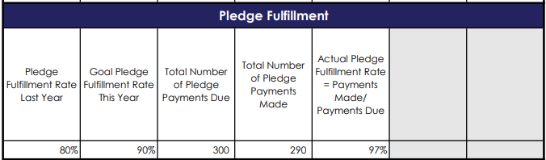
KPIs – Donors – Pledge Fulfillment
Auto cc payments are best
Auto reminders
Still requires good communication and engagement

Slide 23
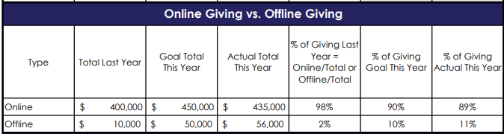
KPIs – Donors – How they give
Offline requires more work
Focus on sources for online giving
Website
Social Media
Texting
Alternate payment methods
Yes, there are cc processing fees, but offset by reduced labor

Slide 24
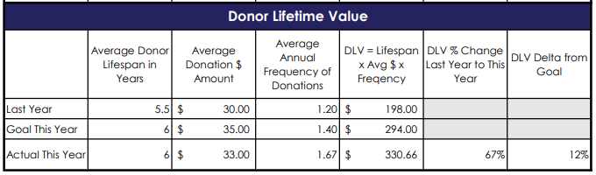
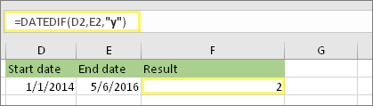
KPIs – Donors – Lifetime Value
More difficult to calculate
Focus on expanding lifespan through engagement
Caution: Numbers can be skewed by a few big donors
TIP: To calculate duration between two dates in Excel, use the DATEIF formular. In this example, the start date is in cell D2, and the end date is in E2. The “y” returns the number of full years between the two dates.

Slide 25
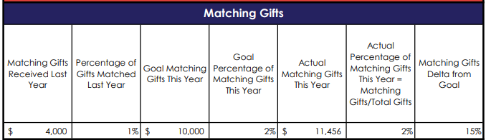
KPIs – Donors – Matching Gifts
Often overlooked
Collect employer names
Include on donation pages & in asks
Great idea for corporate sponsorships to demonstrate support in the community

Slide 26
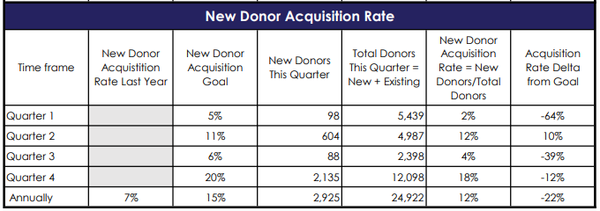
KPIs – Donors – Acquisition Rate
Where have new donors come from in the past?
Brainstorm sources
Social Media
Outreach
Direct Mail
Peer to Peer Campaigns
Have a plan to welcome new donors
Focus on engagement

Slide 27
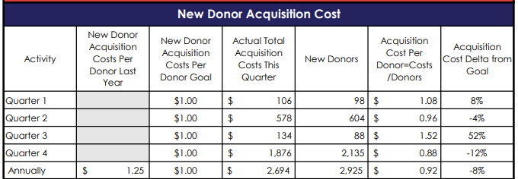
KPIs – Fundraising Costs – New Donors
Costs more to acquire new donors
Base goal on potential lifetime value
Address attrition and growth
Focus on finding and connecting with those who share your values
Requires knowing your people

Slide 28
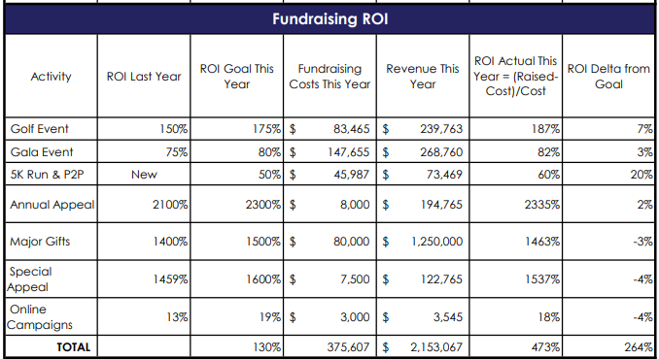
KPIs – Fundraising Costs - ROI
Cost-benefit
Events typically have low ROI
Include staff time in calculations
May consider dropping or modifying activities to free up resources for more lucrative endeavors

Slide 29
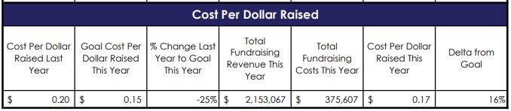
KPIs – Fundraising Costs - CPDR
Similar to ROI
Global view
Include staff costs
Smaller/newer orgs will have higher costs due to outsourcing, higher labor %, and smaller donor base

Slide 30
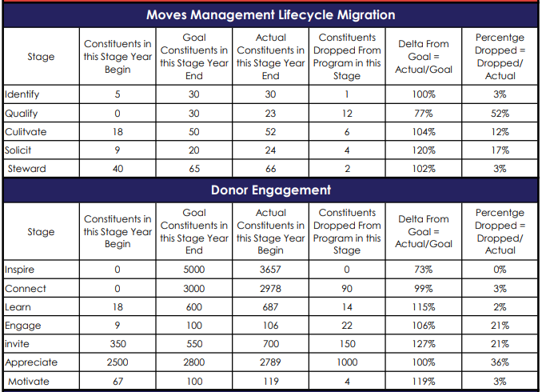
KPIs – Major Gifts/Moves Management
Looks at constituents in each stage
Resource allocation
Track with CRM

Slide 31
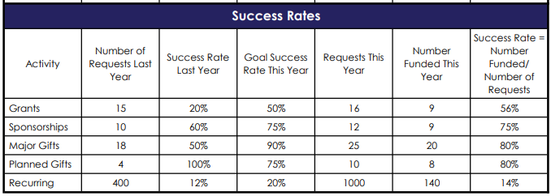
KPIs – Major Gifts/Moves Management - Success
Helps to know how many asks are needed, not just outcomes
Can help identify unreasonable goals
Feedback for moves management process effectiveness

Slide 32
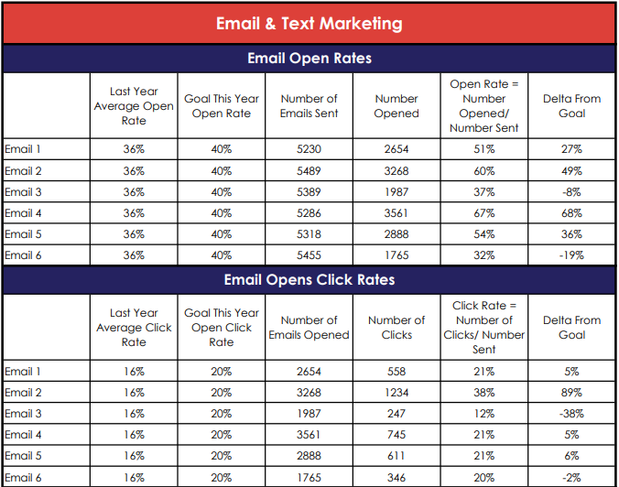
KPIs – Email & Text Marketing – Opens & Clicks
Track each message
Clicks are more valuable than opens
Solicit feedback from readers
Donor-centric!!!!
Make it fun – add polls and games
Call to action

Slide 33
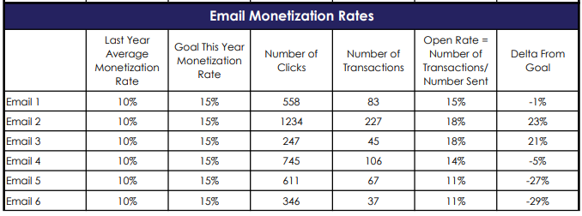
KPIs – Email & Text Marketing - Monetization
Breakdowns from annual plan
Sort by type
Goals
Reasonable
Resources
Plan
Monthly or quarterly updates

Slide 34
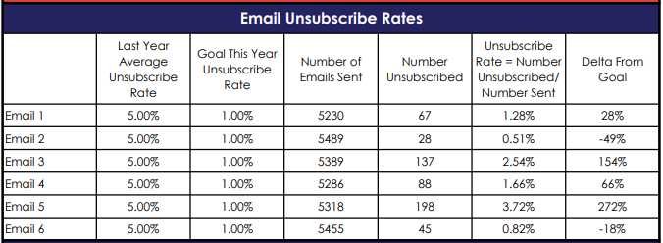
KPIs – Email & Text Marketing
Breakdowns from annual plan
Sort by type
Goals
Reasonable
Resources
Plan
Monthly or quarterly updates

Slide 35
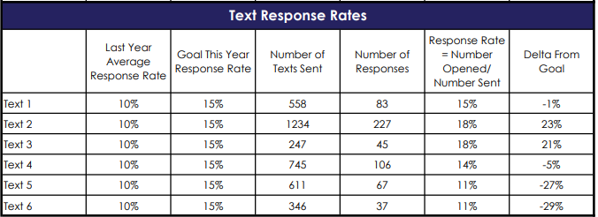
KPIs – Email & Text Marketing - Conversions
Click = interest
Transaction = inspiration + commitment
Always an opportunity for a survey or poll – Why did or didn’t you?

Slide 36
KPIs – Website & Social Media Analytics
Can’t improve until you understand
Free tools available
Google website analytics https://www.google.com/nonprofits/resources/how-to-guide/googleanalytics/
Each platform has free analytics tools
Low-cost social media analytics & scheduling Buffer.com ($6 a month/channel)

Slide 37
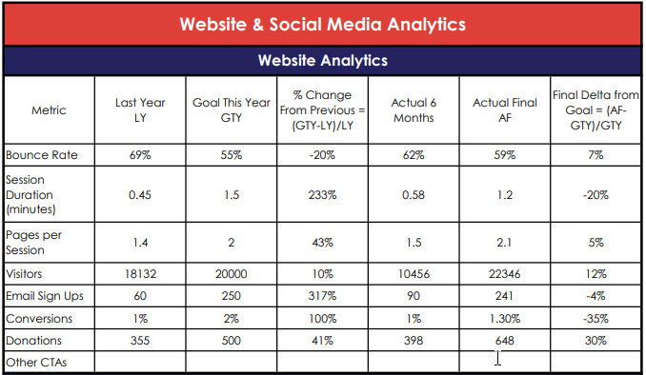
KPIs – Website & Social Media Analytics
Bounce rate: 60% average for nonprofits
Session duration: 2 -3 minutes is good
Pages/session: higher = more engagement
Visitors
Email sign ups
Conversions: Average is 1% for all CTAs
# of Donations
Other Calls to Action

Slide 38
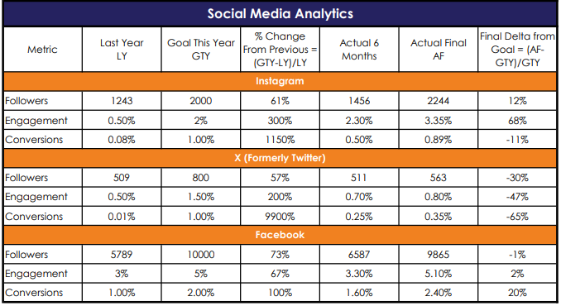
KPIs – Website & Social Media Analytics
Followers
Engagement
Likes
Shares
Comments
Conversions

Slide 39
KPIs – Process
Strategy
Strategy
Objective
Measure
Evaluate
Optimize
Perform
Objective
Perform
KPI
Measure
Optimize
Evaluate

Slide 40
Download the free Fundraising Plan Excel worksheets Donorview.com/AFPwebinars

Slide 41

THANK YOU!
Request a Demo
Scan to visit our website and set up a free demo!
DonorView.com/Demo
Contact Us:
508-205-0243
sales@donorview.com
donorview.com

Slide 42
Questions?

